Slide 1

Guide: Prof. P. M. Gavali
Deep Neural Network Optimization

Slide 2
Group Members
Chetan Prakash Bavache 19UCS010
Pranav Yashwant Bhokare 19UCS014
Akshay Ananda Chougale 19UCS022
Omkar Raju Dhanale 19UCS030
Kishor Shashikant Hange 19UCS042

Slide 3
Introduction
The inspiration behind neural networks is the remarkable human brain. Artificial neural networks (ANNs) are an attempt to simulate the network of neurons that make up the human brain, enabling computers to learn and make decisions in a human-like manner. ANNs are created by programming regular computers to behave as interconnected brain cells. Similar to the human brain, neural networks consist of a large number of interconnected elements that mimic neurons. These elements, also known as artificial neurons or nodes, receive inputs, perform computations, and produce outputs.
By leveraging the interconnectedness and parallel processing capability of these artificial neurons, neural networks can process vast amounts of data, recognize complex patterns, and make predictions or decisions. This bio-inspired approach has revolutionized fields such as computer vision, natural language processing, and speech recognition, enabling machines to perform tasks that were once thought to be exclusive to human intelligence.
Optimizers play a crucial role in training neural networks, although many may be using them without realizing they are applying optimization techniques. Optimizers are algorithms or methods used to change the attributes of a neural network, such as weights and learning rates, to reduce the losses and improve performance. An optimization problem can be categorized as either linear or nonlinear.

Slide 4
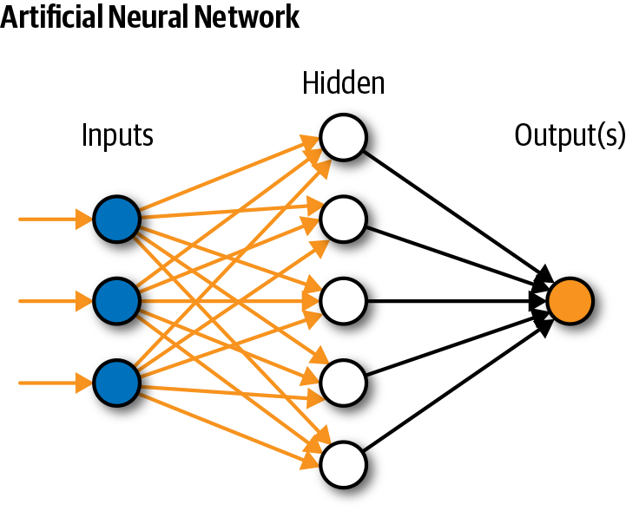
Introduction
Linear optimization problems involve objective functions and constraints that are linear. These problems are relatively simpler and easier to solve, as all linear functions are convex. On the other hand, nonlinear optimization problems are more complex, as the decision space is nonconvex and the objective function may have multiple local optima. Finding the global solution, which is the optimal solution among all possible solutions, becomes challenging in such cases. Various optimization algorithms, such as gradient descent, stochastic gradient descent, and Adam, are employed to navigate the complex parameter space of neural networks and find the optimal values for improved performance. These optimization techniques not only enhance the accuracy of neural networks but also accelerate the training process, allowing for the development of more efficient and accurate models.

Slide 5
Introduction
The deployment of deep neural networks on edge devices has the potential to revolutionize various industries and domains. In the healthcare sector, edge devices equipped with deep neural networks can enable real-time monitoring of patients, allowing for early detection of medical conditions and personalized treatment recommendations. This has the potential to greatly improve patient outcomes and reduce the burden on healthcare systems. Furthermore, in the field of agriculture, deep neural networks deployed on edge devices can analyse sensor data from farms to optimize irrigation, fertilization, and pest control, leading to increased crop yields and resource efficiency.
Edge devices with embedded deep neural networks can also enhance security systems by enabling real-time video analysis for surveillance and intruder detection, making our homes and businesses safer. Moreover, the integration of deep neural networks into edge devices can lead to advancements in autonomous systems. Autonomous vehicles, for example, can benefit greatly from the deployment of deep neural networks on board. These networks can analyse sensor data in real-time, enabling the vehicle to detect and respond to traffic conditions, pedestrians, and obstacles, enhancing safety and enabling more efficient and reliable transportation.

Slide 6
Introduction
In summary, the deployment of deep neural networks on edge devices holds immense potential for various industries and domains. By bringing intelligence and decision-making capabilities closer to the data source, edge devices equipped with deep neural networks can overcome the limitations of cloud-based processing, enabling real-time analysis, reduced latency, improved privacy, and enhanced user experiences. As optimization techniques continue to advance and hardware capabilities improve, we can expect to see a wide range of innovative applications and solutions that harness the power of deep neural networks on edge devices, transforming the way we interact with technology and unlocking new possibilities for a smarter and more connected world.

Slide 7
Problem Statement
Bulky Multilayer Neural Network takes high computational time and space so it is hard to implement on cutting edge devices, so it is proposed to optimize neural network.

Slide 8
Problem Description
As Deep neural networks give better result than machine learning algorithms but due to their bulky structure they require high computation time and high memory usage they are not implementable on edge devices like IoT, camera and smartphone.
Hence, deep neural optimization is required to implement the deep neural network model on devices which have less memory and less computation power, but by maintaining same accuracy of the model.

Slide 9
Scope
Using neural network, we get better accuracy than general machine learning algorithms, but we aren’t able to use neural network on edge devices due to neural network’s computation time and memory usage after optimization we are able to use neural network on edge devices like camera, IoT devices, etc.
The project is mainly focused on software optimization of deep neural network and constraint is to have same accuracy of optimized model as the original model but the accuracy varies in considerable range. The project not focused on hardware optimization.

Slide 10
Goals and Objectives
1. The primary objective of this project is to optimize the network complexity of deep neural networks, striking a balance between model efficiency and accuracy.
By reducing the network complexity, we aim to enable the deployment of deep neural networks on resource-constrained devices, such as edge devices and mobile devices, without compromising their performance.
2. Utilize model to decrease the amount of time needed for model calculation.
Another objective of this project is to leverage advanced techniques and methodologies to significantly reduce the time required for model calculation in deep neural networks, enhancing their efficiency and responsiveness.
3. Utilize an improved model to save memory.
By optimizing the model architecture and parameters, we aim to reduce the memory footprint of deep neural networks without compromising their performance and accuracy, enabling their deployment on memory-limited devices such as edge devices and mobile platforms.

Slide 11
Aim
Design and develop solution to optimize the Deep Neural Network.
The aim of this project is to design and develop an innovative solution to optimize Deep Neural Networks (DNNs) and improve their performance and efficiency. The proposed solution will involve a multi-faceted approach that encompasses various aspects of DNN optimization, including model architecture, parameter tuning, regularization techniques, and data pre-processing. By carefully analysing the specific challenges and requirements of the DNN model, we will identify areas for improvement and develop novel strategies to enhance its overall performance. Through rigorous experimentation and iterative refinement, we aim to create a robust and efficient solution that maximizes the accuracy and computational efficiency of DNNs, making them more suitable for resource-constrained environments such as edge devices and mobile platforms. The ultimate objective is to empower businesses and industries with optimized DNN models that can unlock new possibilities and deliver superior results in applications such as computer vision, natural language processing, and speech recognition.

Slide 12
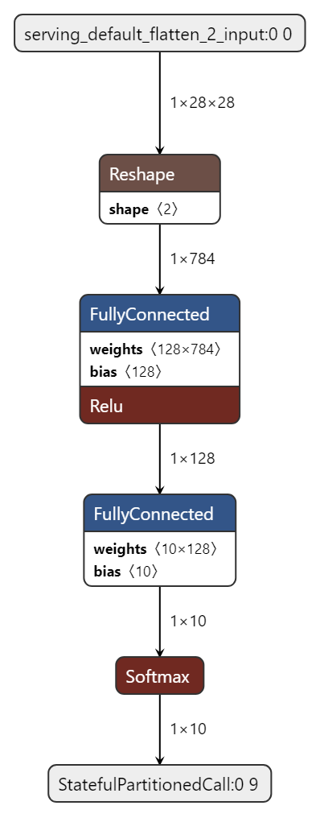
Methodology
Creating model & generating graph using netron.ai.
Conversion of model into ONNX & TFLITE model.
Convert TFLITE model into ONNX & generate graph of both models.
Both the ONNX models feed into TVM compiler and generate graph.
Compare all the 5 graphs & pick a model with best performance in time & space having same accuracy as original model

Slide 13
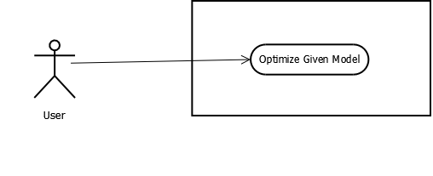
Use Case
System

Slide 14
Activity Diagram

Slide 15
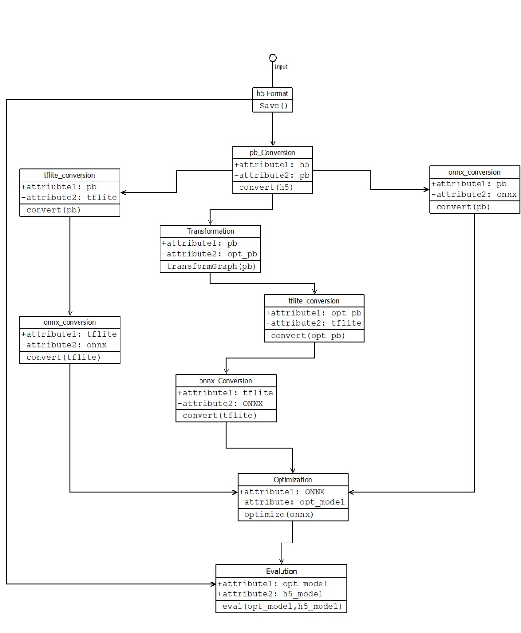
Class Diagram

Slide 16
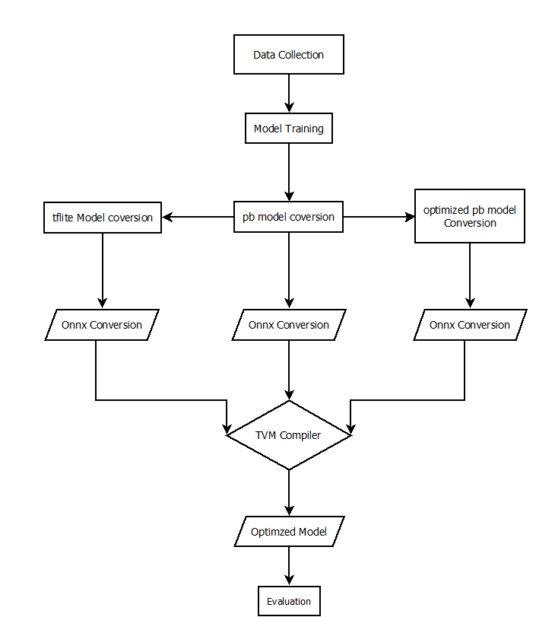
Detailed Design

Slide 17
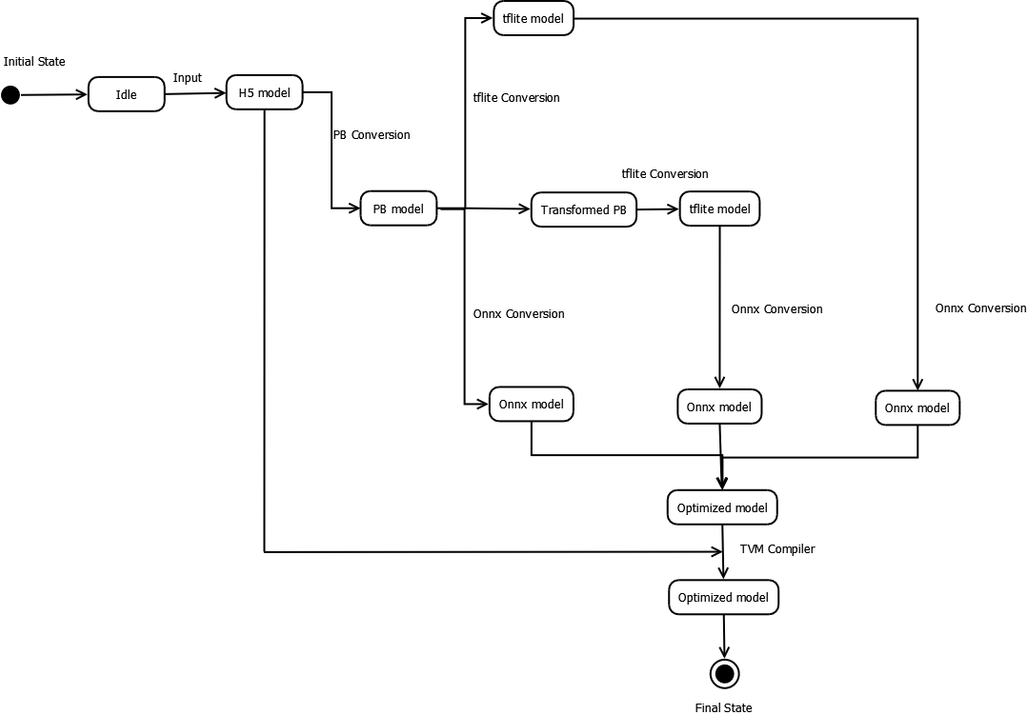
State chart Diagram

Slide 18
Deployment Diagram

Slide 19
Algorithm
1.Start
2.Conversion of H5 format to PB format
1.Save Model in H5.
2. Import TensorFlow library
3. Load a PB File
4.Convert the model into graph.
5.Convert the graph into PB.
6.Save model.
3.Optimize PB format model.
1. Import TensorFlow library
2. Load a PB file.
3. Optimize the PB model using transform_graph function.
4. Save Model in PB format.

Slide 20
Algorithm
4.Convert PB format to tflite format
1. Import TensorFlow library.
2. Load a PB file.
3. Convert the PB format file in tflite format using TFLiteConverter.
4. Save Model in tflite format.
5.Convert tflite format to ONNX format
1. Import onnxruntime library.
2. Load a tflite file.
3. Convert the tflite format to onnx file format using tflite2onnx.
4. Save Model in ONNX format.

Slide 21
Algorithm
6.Convert PB format to ONNX format
1. Import onnxruntime library.
2. Load a PB file.
3. Convert the tflite format to onnx file format using tflite2onnx.
4. Save Model in ONNX format.
7.Optimize given model using TVM compiler.
1. Compiling an ONNX Model to the TVM Runtime.
2. Running the Model from The Compiled Module with TVMC.
3. Evaluating the model.
8. End.

Slide 22
Facilities Required
Hardware requirements:
Number | Description | Alternatives (If available)
1 | PC with 2 GB hard-disk and 8 GB RAM | Not Applicable
2 | Integrated Graphics Card | NVIDIA
Software requirements:
Number | Description | Alternatives (If available)
1 | Windows 7/10/11 Or Ubuntu | Not Applicable
2 | Python 3.0 or above | Not Applicable
3 | TensorFlow 2.0v or above | Not Applicable
4 | TF Lite | Not Applicable

Slide 23
References
Hanan Hussain “Design possibilities and challenges of DNN models: a review on the perspective of end devices,” Springer Nature,16 January 2022
Peemen, M., Setio, A. A. A., Mesman, B., & Corporaal, H. (2013). “Memory-centric accelerator design for Convolutional Neural Networks”. 2013 IEEE 31st International Conference on Computer Design (ICCD).
Qingchao Shen, “A Comprehensive Study of Deep Learning Compiler Bugs”, ACM Conferences, 4, 18 August 2021.
Arvind Krishnamurthy, “TVM: An Automated End-to-End Optimizing Compiler for Deep Learning”, Carlsbad CA US, 579–594, 08 October 2018.
Ananthram Swami, “The Limitations of Deep Learning in Adversarial Settings”, 2016 IEEE European Symposium on Security and Privacy (Euro S&P), 12 May 2016.
Pavel Kordik, “Meta Learning approach to Neural Network Optimization”, The 18th International Conference on Artificial Neural Networks, ICANN 2008, Vol-23, 578, May 2010.

Slide 24
References
Hanan Hussain “Design possibilities and challenges of DNN models: a review on the perspective of end devices,” Springer Nature,16 January 2022
Peemen, M., Setio, A. A. A., Mesman, B., & Corporaal, H. (2013). “Memory-centric accelerator design for Convolutional Neural Networks”. 2013 IEEE 31st International Conference on Computer Design (ICCD).
Qingchao Shen, “A Comprehensive Study of Deep Learning Compiler Bugs”, ACM Conferences, 4, 18 August 2021.
Arvind Krishnamurthy, “TVM: An Automated End-to-End Optimizing Compiler for Deep Learning”, Carlsbad CA US, 579–594, 08 October 2018.
Ananthram Swami, “The Limitations of Deep Learning in Adversarial Settings”, 2016 IEEE European Symposium on Security and Privacy (Euro S&P), 12 May 2016.
Pavel Kordik, “Meta Learning approach to Neural Network Optimization”, The 18th International Conference on Artificial Neural Networks, ICANN 2008, Vol-23, 578, May 2010.

Slide 25
Thank You!!
NEIL TRAN
Content
Depa

